Slide 1
Introducing Little Wandle Letters and Sounds Revised
This year we have introduced a new phonics and early reading programme called Little Wandle Letters and Sounds Revised.
It is a government recommended phonics programme, which aims to ensure all children can fluently decode and read texts using phonics by the end of Year 1.
It is a complete synthetic phonics programme with a consistent approach that uses daily phonics teaching sessions, group reads along with catch-up interventions and half-termly assessments.
It is vital that you as parents/carers understand and support the school through this process as you play such a significant role in helping your child learn to read and develop a love of reading.

Slide 2
Research has shown that being able to read fluently by the age of 6 has a strong correlation with future academic success.
If children can read fluently, they are better able to access all areas of the curriculum.
‘If we learn to read, we can read to learn.’
Decoding using phonics is the most reliable method to work out unknown words which is why automatic decoding is the ultimate aim of the programme.

Slide 5
Phoneme
The smallest unit of sound that can be identified in words.
Grapheme
A letter or group of letters used to represent a particular phoneme when writing.
Digraph
Two letters that make one sound (phoneme) e.g. sh shop
Trigraph
Three letters that make one sound (phoneme) e.g. igh light
Split vowel digraph
A vowel sound where its two letters are split by a consonant
e.g. a_e make

Slide 6
Blending

Slide 7
Blending
Some children learn to blend really quickly, and others take a little longer.
Information video link: https://www.littlewandlelettersandsounds.org.uk/resources/for-parents/

Slide 8
Tricky words
High-frequency words that, although decodable in themselves, cannot be decoded by children using the GPCs they have been taught up to that point.
Examples: the go we of

Slide 9
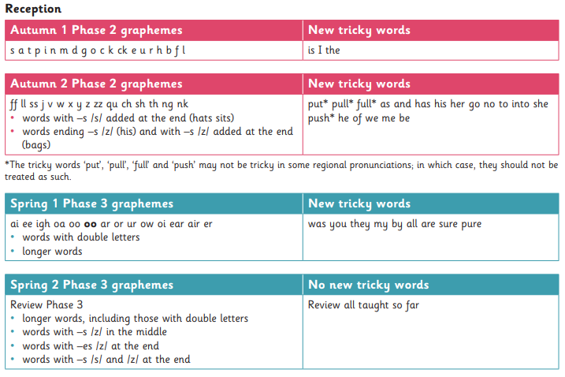
Programme progression
On the school website

Slide 10
Daily phonics sessions
Revisit and review: The children will revise previous learning by recapping known phonemes, words and tricky words.
Teach and practise: New phonemes, words and tricky words will be taught. The children will practise the new learning by blending to read words.
Four new phonemes a week with a review on Fridays.
Practise and apply: The children will apply their new learning by reading and/or writing words and sentences.
Assess and review every 6 weeks

Slide 11
What has changed?
Children will be expected to use phonics only to work out unknown words and must not be encouraged to guess or work out the word using other cues such as pictures.
In school, children will only be expected to read independently books that they can read at 90% fluency, this means that they only have to decode 1 word out of every 10.
At home, children will only be expected to read books that they can read with 90-95% fluency. These books will only contain graphemes and tricky words that they have already been taught.

Slide 12
Supporting your child’s reading at home
It may seem that the book your child has been given is too easy but the whole point is for them to develop their fluency and confidence using the graphemes and tricky words that they have been taught.
Your child should be able to read the practice book with developing confidence and fluency without any significant help. The front page helps you to know which phonemes and words are within the book.
Your role is to listen with interest and, most importantly, to encourage and praise, enthusiastically acknowledging the child’s achievement (even if, at the early stages, this is only small).
After the child has read the book, it may be helpful to talk about the book (using the back page as a prompt), but only so far as the child is interested. It is vital that you keep the reading experience positive and avoid turning it into a test.
Book bands: we will no longer use these to assign books. The books that children take home will be matched to their secure phonic knowledge.

Slide 13
In summary…
There are two types of reading book that your child may bring home:
1) Reading Practice Book (ebook and book): This will be at the correct phonic stage for your child. They should be able to read this fluently and independently.
2) Sharing Book: Your child will not be able to read this on their own. This book is for you both to read and enjoy together.

Slide 14
Reading Practice Book
This book has been carefully matched to your child’s current reading level. If your child is reading it with little help, please don’t worry that it’s too easy – your child needs to develop fluency and confidence in reading.
Listen to them read the book. Remember to give them lots of praise – celebrate their success! If they can’t read a word, read it to them. After they have finished, talk about the book together.

Slide 15
Sharing Book
In order to encourage your child to become a lifelong reader, it is important that they learn to read for pleasure. The sharing book is a book they have chosen for you to enjoy together.
Please remember that you shouldn’t expect your child to read this alone. Read it to or with them. Discuss the pictures, enjoy the story, predict what might happen next, use different voices for the characters, explore the facts in a non-fiction book. The main thing is that you have fun!

Slide 16
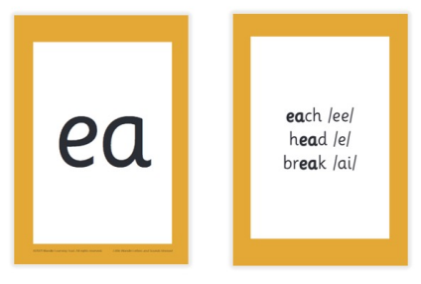
Spelling

Slide 18
Further support
https://www.littlewandlelettersandsounds.
org.uk/resources/for-parents/
The school website has the Little Wandle link, further information
and resource sheets.

