Slide 1
What is Accelerated reader?
An online reading programme that monitors and assesses children’s comprehension and vocabulary knowledge (Y2 – Y6)
Uses a huge variety of interesting book.
Over 31,000 different quizzes to take.
Tests and assesses children regularly.
Analyses data after every quiz or test.

Slide 2
Why change to Accelerated Reader?
Accelerated progress
No more ‘free readers’
Appropriate challenge
Valuable data
Extensive choice
Motivational Quizzes
Valuable data

Slide 3
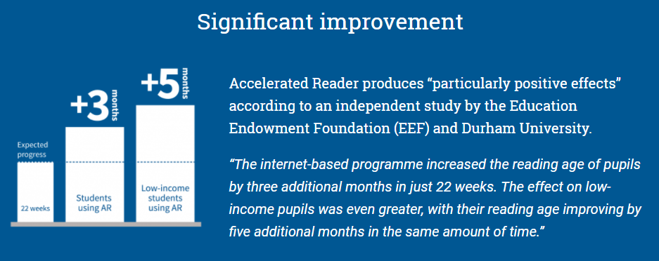
Why change to Accelerated Reader?
Accelerated Progress

Slide 4
Why change to Accelerated Reader?
No more ‘free readers’
Problems with free readers:
Free readers are hard to track
Not choosing appropriate books
Lose interest in reading because they have nothing to work towards
Benefits of Accelerated Reader:
Tracked throughout their whole school experience
Still have access to the same books
Are given a range in which they choose books that are appropriate to their understanding
Test children’s comprehension and vocabulary understanding rather than their decoding of words.

Slide 5
Why change to Accelerated Reader?
Appropriate Challenge
Children take a Star Reading Test (comprehension, vocabulary and reading speed )
Given reading range (ZPD)
Complete another Star reading test 6 weeks later

Slide 6
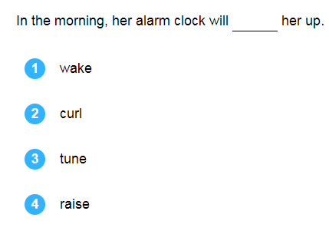
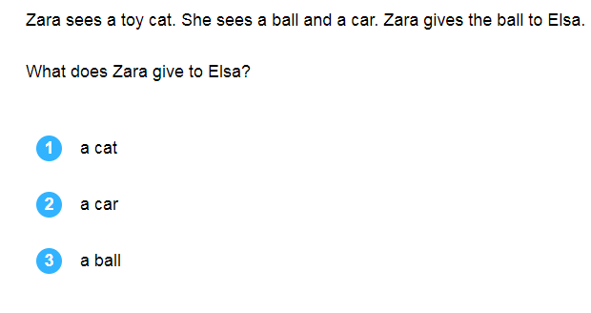
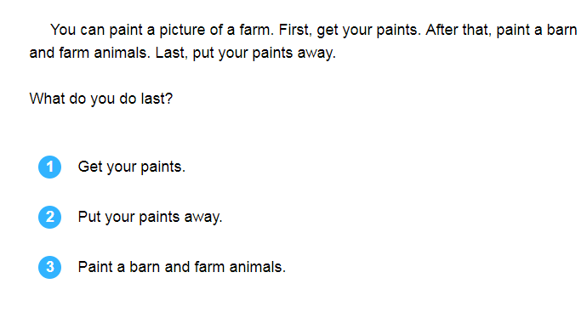
Why change to Accelerated Reader?

Slide 7
Why change to Accelerated Reader?

Slide 8
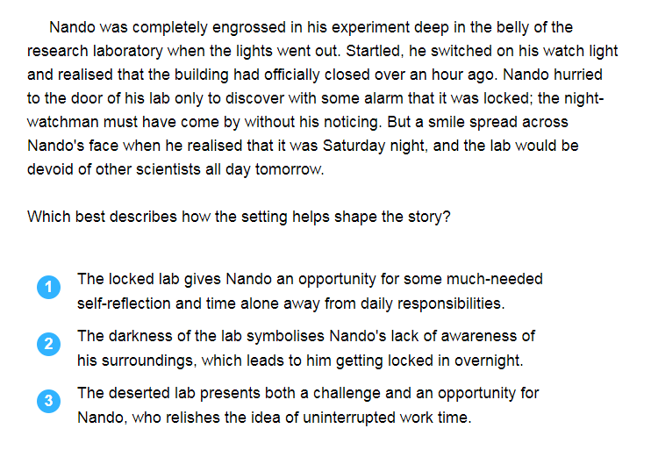
Why change to Accelerated Reader?

Slide 9
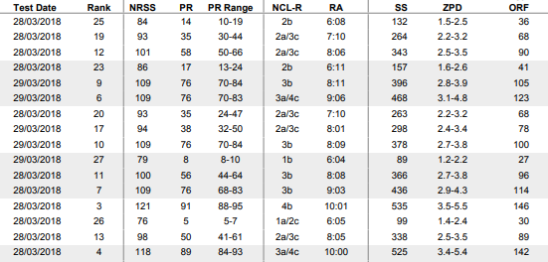
Why change to Accelerated Reader?
Valuable data
After a Star Reading test:

Slide 10
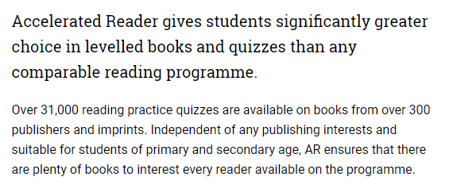
Why change to Accelerated Reader?
Extensive choice
Who is bored of Biff and Chip?

Slide 11
Why change to Accelerated Reader?
Motivational quizzes
Quizzes taken after every book read
Feedback given straight away
Targets to work towards (points/ 85%)
School incentives (millionaire readers, class competitions)
Let’s try a quiz

Slide 12
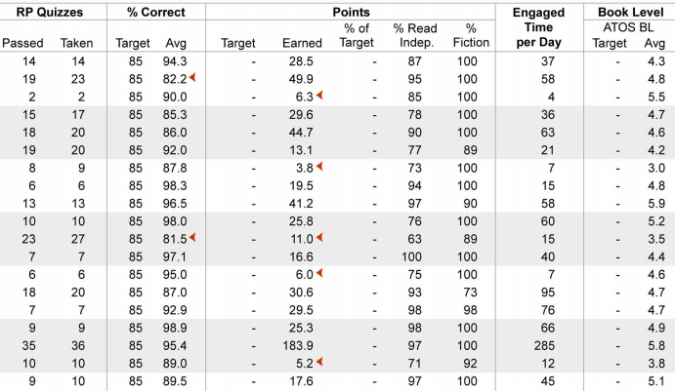
Why change to Accelerated Reader?
Valuable data
After a reading quizz:

Slide 13
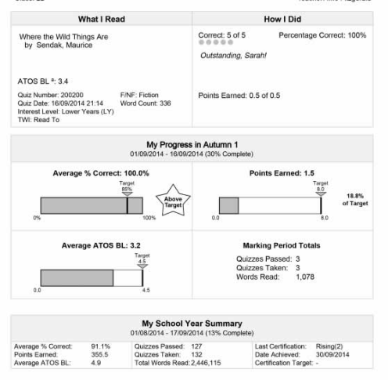
Valuable data
After a reading quizz:

Slide 14
How can you help?
Give us time
AR bookfinder
Any unwanted books that are in good condition
Ideas to raise money
Thank you….
Any questions?

