Slide 1
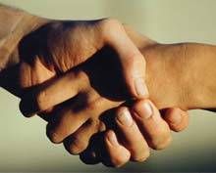
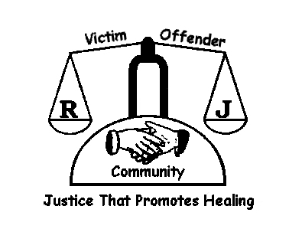
Restorative practice
To examine this method of conflict resolution.

Slide 2
Starter:
Read the letter on the following slide then you will be given a task in which you must answer questions about this letter.

Slide 3
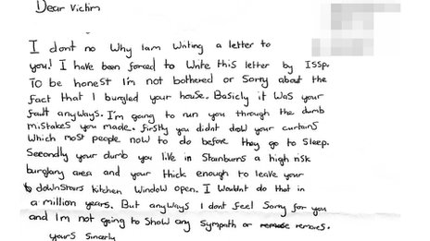

Slide 4
Was making the criminal write a ‘sorry’ letter to the victim a good punishment?

Slide 5
If you were the victim, would you feel happy?

Slide 6
Do you think the criminal has learnt from what they have done wrong?

Slide 7
How could we make the criminal understand what they have done wrong?

Slide 8
What punishment would you have given the criminal?

Slide 9
What is Restorative practice?
Is all about ‘restoring’ peace and harmony to a situation. Making sure all sides understand WHAT has happened and HOW it can be repaired
Write your own definition…

Slide 10
What can RJ do for a School?
Happier and safer school
Mutually respectful relationships
More effective teaching and learning
Reducing exclusions
Raising attendance
Developing emotional literacy
Addressing bullying behaviours
Raising morale by culture of inclusion and belonging
Reduces entry into CJS
IT IS NOT A SOFT OPTION
Video clip: https://www.youtube.com/watch?v=JfiGiA2bpoY

Slide 11
What is Restorative Justice Conferencing ?
A process for resolving conflict
A common language to resolve conflict
Focuses on the needs of the victim
Allows the wrongdoer(s) to understand the impact of their actions
Encourages wrongdoer(s) to take responsibility for their actions
Therefore creates accountability
Likely to change behaviour and build character

Slide 12
Implementation: The First Step
Restorative language, contracts, class room rules
Check in and check out in form
Rest. chats to resolve low level conflict
RJ Conferencing to resolve high level conflict
Training
Resources, Info. for Parents, Staff, Pupils

Slide 13
Outcomes
All will be able to describe what restorative practice is
Most will be able to apply the rules of restorative practice to a case study and analyse if it is an effective method of conflict resolution
Some will be able to create a successful role play showing restorative justice in practice.

Slide 14
For each scenario you must decide:
What happened?
Who was harmed?
How can it be repaired?

Slide 15
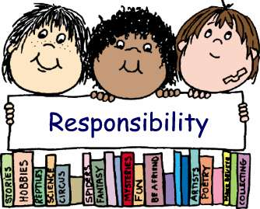
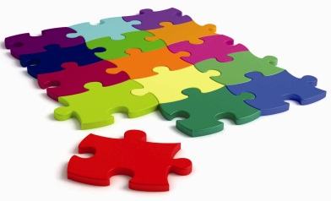
RP is based on FOUR R’s!
RESPECT –For everyone by listening to other
opinions and learning to value them
RESPONSIBILTY - Taking responsibility for your own
actions
REPAIR – repair harm and ensure behaviour is not
repeated (Consequence for actions)
RE-INTEGRATION - working through a structured, supportive process that aims to solve the problem and help everyone reach a positive outcome.

Slide 16
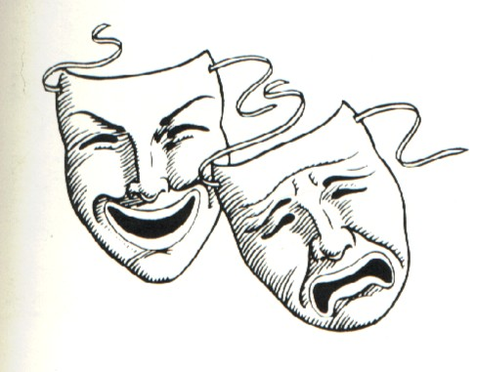
ROLE PLAY
So how should we deal with this in school? We are going to role play a scenario for you
ROLES:
Perpetrator (Main bully) - Julie
Victim (Person who feels attacked) - Sarah
Mediator (Person asking the BIG questions) - Fiona
Observer 2 (Watch and observe how the situation is handled/resolved (Feedback at the end) - Jo
It can be about any issue that involves conflict:
Here we are looking at bullying
https://www.youtube.com/watch?v=JfiGiA2bpoY

Slide 17
The BIG Questions
What happened?
What were you thinking about at the time?
What have been your thoughts since?
Who has been affected?
What do you think you need to do to make things right?

Slide 18
What happened?
What were you thinking about at the time?
What have been your thoughts since?
Who has been affected?
What do you think you need to do to make things right?
What happened?
What were you thinking about at the time?
What have been your thoughts since?
Who has been affected?
What do you think you need to do to make things right?
What happened?
What were you thinking about at the time?
What have been your thoughts since?
Who has been affected?
What do you think you need to do to make things right?
What happened?
What were you thinking about at the time?
What have been your thoughts since?
Who has been affected?
What do you think you need to do to make things right?
What happened?
What were you thinking about at the time?
What have been your thoughts since?
Who has been affected?
What do you think you need to do to make things right?
What happened?
What were you thinking about at the time?
What have been your thoughts since?
Who has been affected?
What do you think you need to do to make things right?

Slide 19
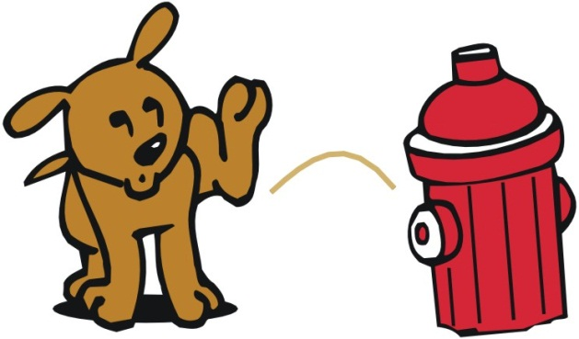
Reflection
Do you think Restorative practice
Is a a good way of resolving conflict….
Discuss on your tables and feedback

Slide 20
Where am I at today?
All will be able to describe what restorative practice is
Most will be able to apply the rules of restorative practice to a case study and analyse if it is an effective method of conflict resolution
Some will be able to create a successful role play showing restorative justice in practice.

